Slide 1

GSM BASED HOME SECURITY ALARM SYSTEM USING AURDUINO
Batch No: 180232
Guided by
Prof. Balu Laxman Parne
Dept. of CSE
Team Members
1. CH.SAI TEJA [18BCD7157]
2. J.N.V.S. TEJASWI [18BCD7100]
3. B.GHANA SHYAM[18BCD7085]
4. T. SATYA KUMAR[18BEC7113]
5. A. CHIRUN TEJA[18BCD7160]
6. K.SUCHITH REDDY[18BCN7012]

Slide 2
Agenda
Completed working prototype
Architecture/Design circuits
Objectives meeting outcome
Results with Screenshots
Future improvements can be made
references

Slide 3
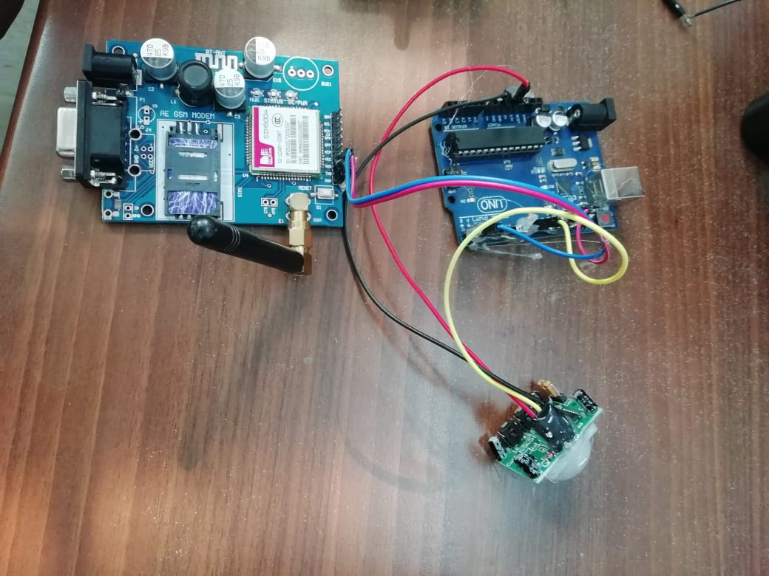
Completed working prototype

Slide 4
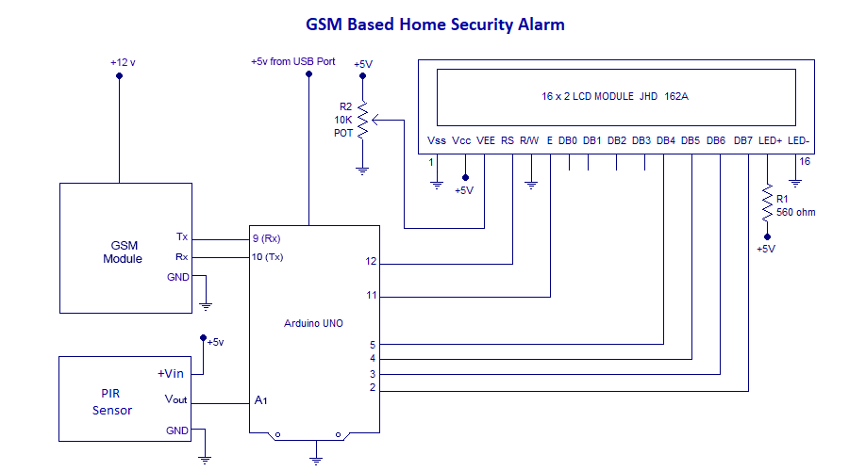
Architecture/Design circuits

Slide 5
Objectives meeting outcome
The following objectives has been accomplished by our working prototype
As we mentioned before our objectives were as follows
The objective of this project is to design and develop a wireless communication link to monitor our organizations that require high security like banks, offices, prisons, shopping malls, museums ,etc..
To get to know the information of the trespasser’s in time with less effort.
To decrease the cost of security systems.
Our security systems are also can be used in military boarder areas to prevent trespasser’s.

Slide 6
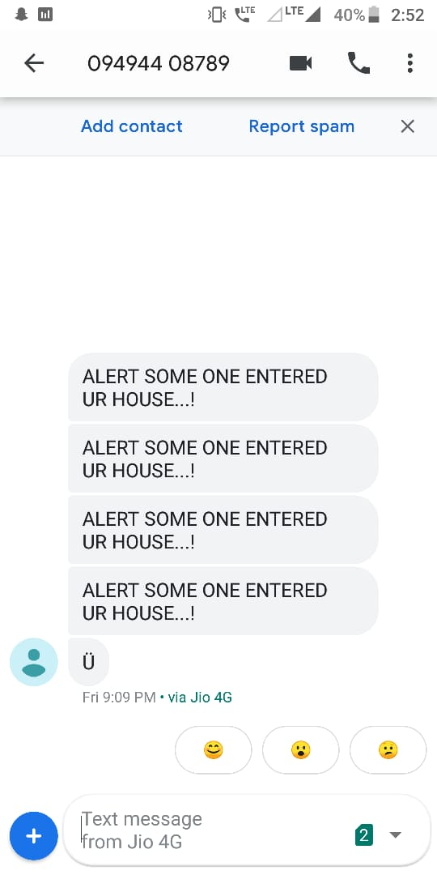
Results with Screenshots

Slide 7
Future improvements can be made
For now working prototype can send message’s to the owner in future it may make calls to the owner
Now it sends message because some one has entered the room later it may describe the person
The accuracy of the model can be improvised from a small region to a big region
The same concept can be used to send message through satellite signals so that we can use in the places where the telecom signals are not available

Slide 8
References
1. http://studytronics.weebly.com/projects/advanced-home-security-system-using-arduino
2. https://www.engineersgarage.com/contribution/arduino-based-security-system-using-gsm-and-pir-sensor

Slide 9
THANK YOU

